Slide 1
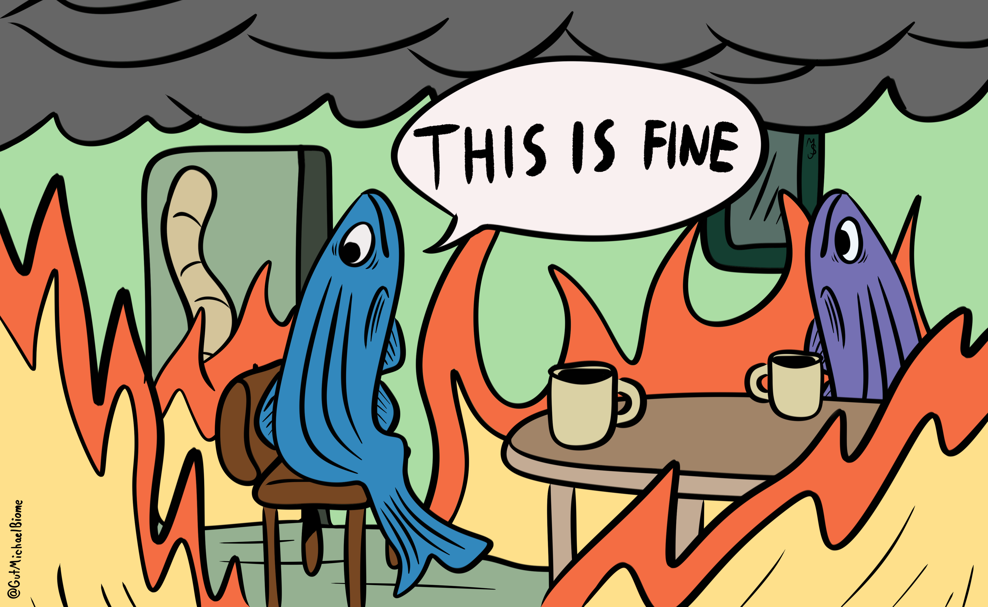

Modeling the gut microbiome's resistance and resilience to climate change and infection in zebrafish
Michael Sieler
Sharpton Lab
Department of Microbiology
Beneficial Microbes 2024
Notes:
Hi everyone, my name is Michael Sieler
Today, I will be presenting some results of my study modeling the gut microbiomes resistance and resilience to climate change and infection in zebrafish

Slide 2
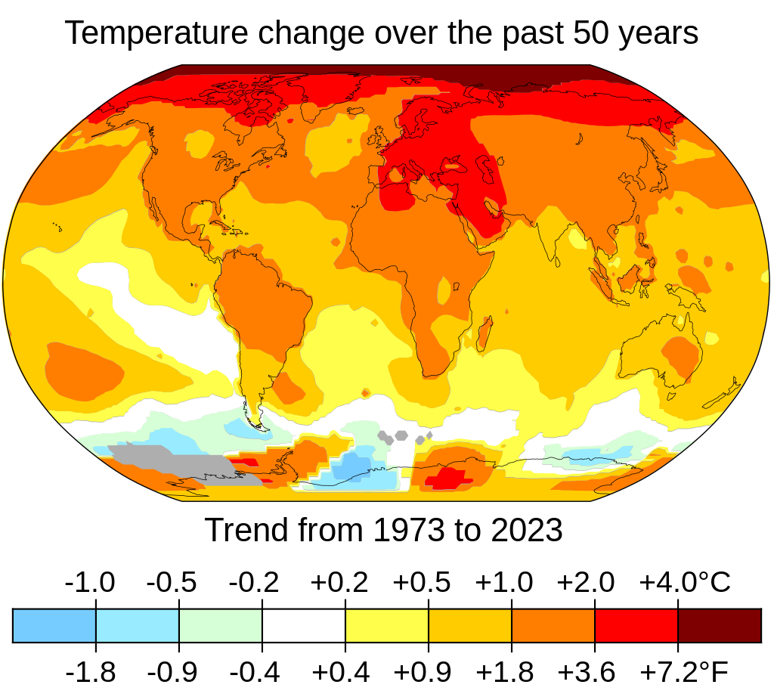
Climate change is anticipated to impact gut microbiome stability to influence host health
Anthropogenic climate change increasing global temperatures impacting wildlife and humans
Climate change anticipated to impact ecosystems and individual health
Range of infectious agents expected to expand
Clarify how exogenous stressors perturb microbiomes, and how climate change may modulate microbiome-infection axis
NASA
Notes:
Anthropogenic climate change is causing increasing global temperatures, and impacting wildlife and human health.
1) Given the gut microbiomes central role in supporting host health and homeostasis by mediating the effects of exogenous stressors, such as those exacerbated by climate change
There is an urgent need for understanding how CC will impact the gut microbiome to influence host health
2) For instance, ecologists anticipate the range of infectious agents, such as intestinal parasites, to expand as global temperatures increase
Of particular concern are the increased intestinal parasite burdens on aquatic organisms experiencing increasing water temperatures
Given that the gut microbiome interfaces with exogenous stressors, such as intestinal parasites, there is a need to clarify how CC may modulate the gut microbiome-infection axis
3) We hypothesized that the gut microbiome's response to an exogenous stressor will vary in terms of its resistance or sensitivity depending on the host's environmental conditions.
Specifically, we anticipated that the gut microbiome would be most sensitive to an exogenous stressor when the environmental conditions vary substantially from their baseline conditions.

Slide 3
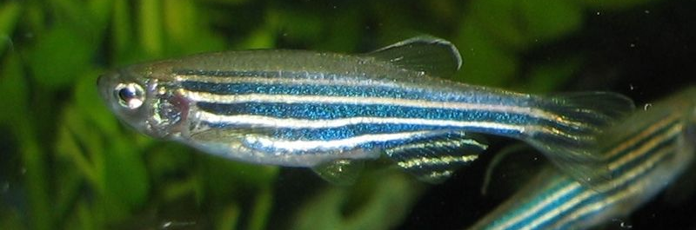
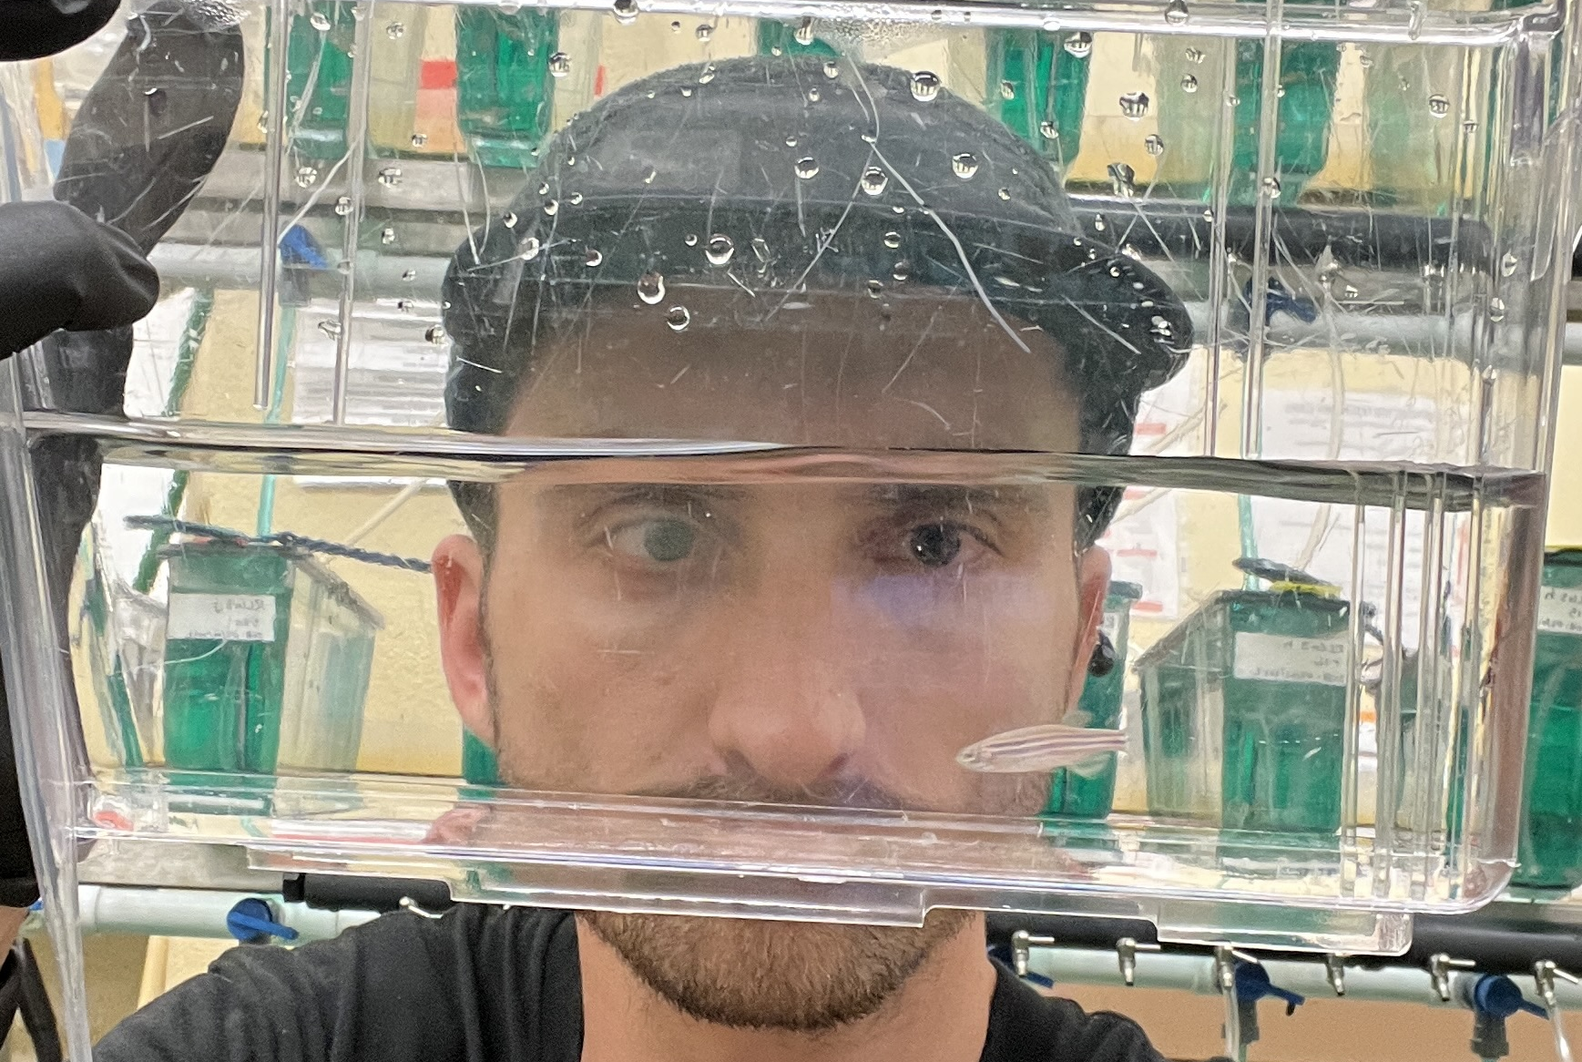
Using zebrafish to clarify how differing environmental conditions and -stressors impact gut microbiomes to influence host health
Zebrafish are an advantageous model organism to interrogate the gut microbiome
Prior work in zebrafish has investigated temperature and infection
Temporal gut microbiome response to the interaction of increasing temperatures and parasite exposure is unclear
Increasing water temperatures and exposure to a common zebrafish intestinal parasite, Pseudocapillaria tomentosa
Notes:
To evaluate the gut microbiome’s response to an exogenous stressor across environmental conditions, we leveraged the zebrafish model system due to the organism’s unique advantages to interrogate the gut microbiome.
Zebrafish are an increasingly popular model organism to study vertebrate-associated microbial communities of the gut microbiome due to their:
Well-established high throughput methods for microbiome manipulation and analysis
Additionally, zebrafish can tolerate a wide spectrum of temperature ranges from 4 to 40 degrees Celsius, despite their thermal optimum being 28 degrees
So this affords us the ability to evaluate their microbiomes response across a gradient of environmental conditions
Prior work in Zebrafish has independently investigated the impacts of altered temperatures and parasite exposure on their gut microbiomes,
but the interaction of these factors and their temporal impacts have not been studied
To clarify the potential impacts of CC on the gut microbiome and host health, we sought to determine how the zebrafish gut microbiome varies across environmental conditions of increasing water temperatures,
as well as measure temporal infection outcomes and gut microbiome response across increasing water temperatures when exposed to the intestinal parasite Pseudocapillaria tomentosa.

Slide 4
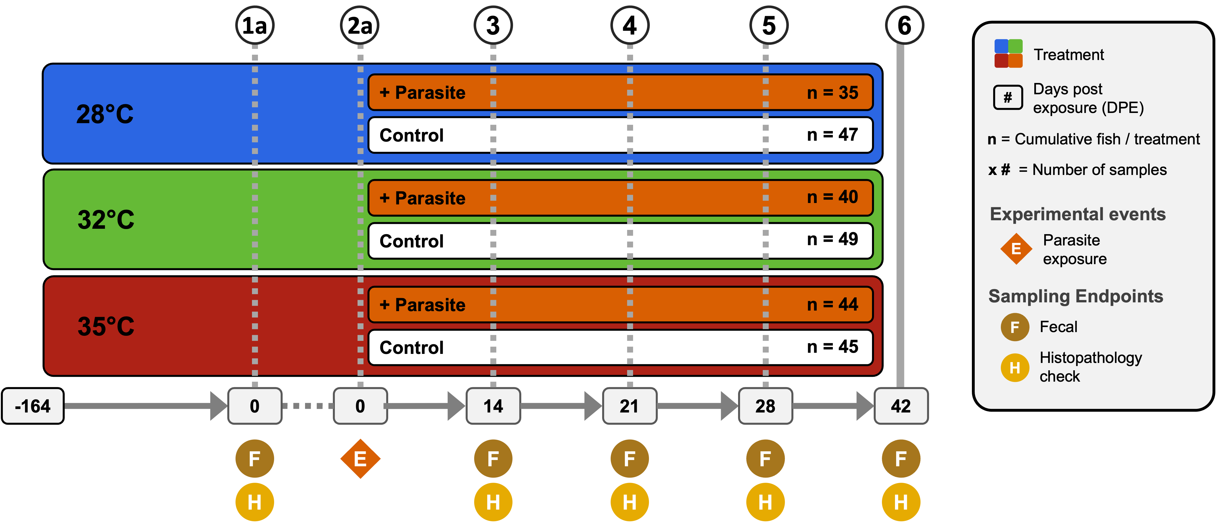
Evaluating temporal microbiome responses and infection outcomes to an intestinal parasite across increasing water temperatures
28°C
32°C
35°C
Notes:
To do this, we reared zebrafish to adulthood and then acclimated them to one of three water temperatures (28, 32 or 35°C)
1) After collecting baseline fecal microbiome samples and assessing intestinal histology, we exposed a cohort of fish from each temperature group to the parasitic worms
2) Between 14 and 42 days post exposure, we collected subsequent fecal microbiome samples and measured worm burden via histological and wet mount assessment

Slide 5
Infection Outcomes
Notes:
First, we sought to determine how water temperature impacted infection outcomes in parasite exposed fish.

Slide 6
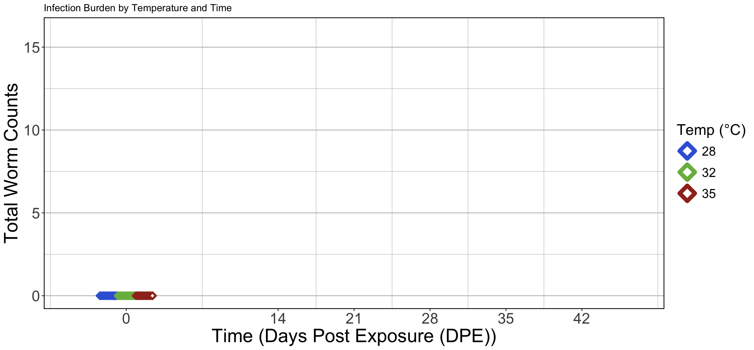
Infection burden over time by temperature group
Notes:
Here we have a figure that will show the total number of worms detected per fish by temperature group across time.
On the y-axis we have number of worms detected per fish
On the x-axis we have time, written as days post exposure
Number of worms per fish will be displayed as diamonds on the plot
Currently, I’m only showing the results of worm counts between the temperature groups, at our baseline sampling timepoint, where all fish have not yet been exposed to parasites

Slide 7
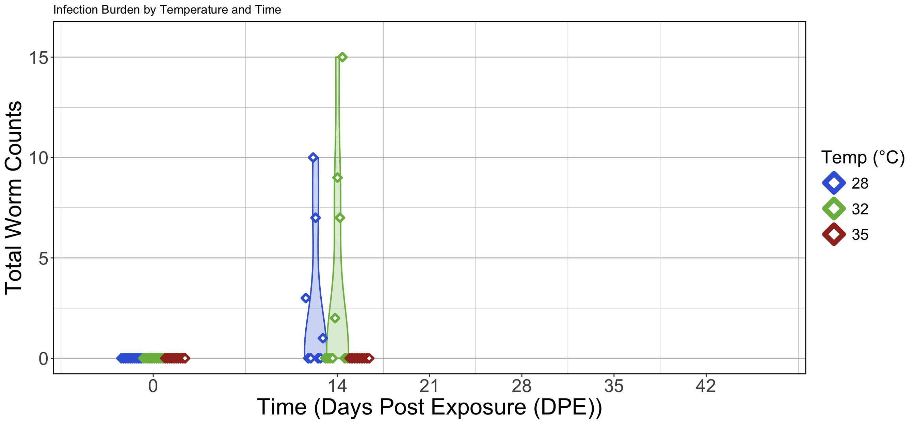
Infection burden observed in fish reared at lower water temperatures
Notes:
Next at 14 days post exposure, we see that fish in the 28 and 32 degree groups have detectable worms.

Slide 8
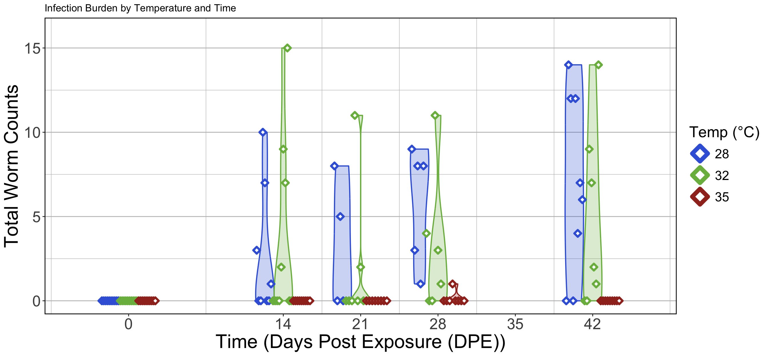
Higher water temperatures may be protective against infection burden
*
*
Notes:
And by the conclusion of our experiment, we see that infection trends in an increasing manner in the lower water temperature fish, while 35 degree fish remain virtually uninfected, except for one instance at 28 days post exposure.
Together, these results suggest that higher water temperatures may be protective against infection.
But more work is needed to fully understand the parasitic worms ability to reproduce and infect fish at each of these water temperatures

Slide 9
Microbiome Response
Notes:
Given the differences in infection outcomes between the fish reared at different water temperatures, we next sought to determine how the microbiome varied across the water temperatures when exposed to a parasite

Slide 10
Measuring microbiome response to an exogenous stressor
Gut microbial diversity
Gut microbial community composition
Infection outcomes by microbiome response
Notes:
To do that, we measured the microbiome's gut microbial diversity, community composition, and then investigated the association between infection outcomes and these microbiome measurements.

Slide 11
Gut Microbial Diversity
Notes:
First I analyzed gut microbiome variation in terms of gut microbial alpha diversity

Slide 12
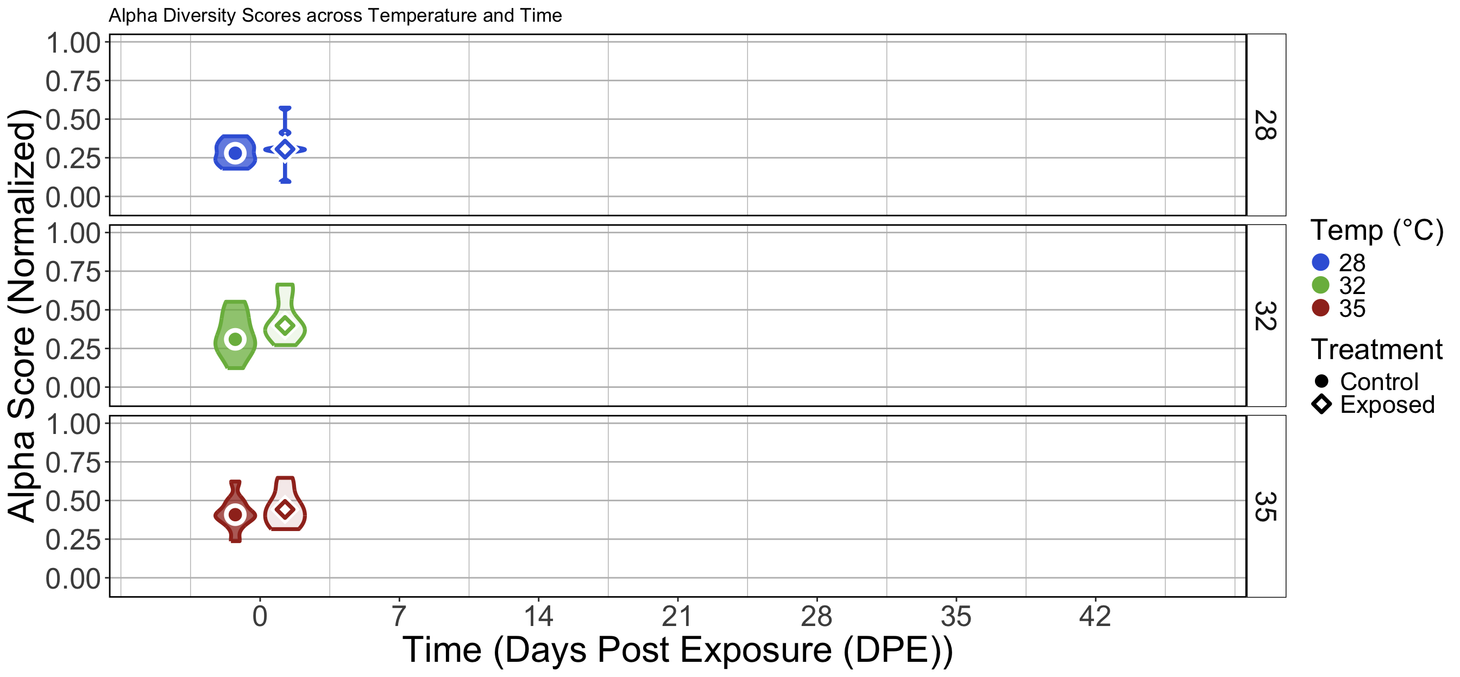
No significant difference between control and exposed fish within temperature groups at baseline sampling
Notes:
Here I’m showing a figure displaying median alpha diversity scores as measured by the Simpson’s Index for each temperature and treatment group across time with violin plots indicating the amount of variation for each group
On the y-axis we have alpha-diversity scores, scaled from 0 to 1 based on minimum and maximum observed values
On the x-axis we have time, written as days post exposure
Median Alpha diversity scores will be displayed as circles or diamonds on the plot corresponding to control or exposed treatment groups with corresponding colors indicating water temperature
Here I have the results for our baseline sampling time point at 0 days post exposure,
As expected we see no statistically significant differences between the treatment groups prior to parasite exposure

Slide 13
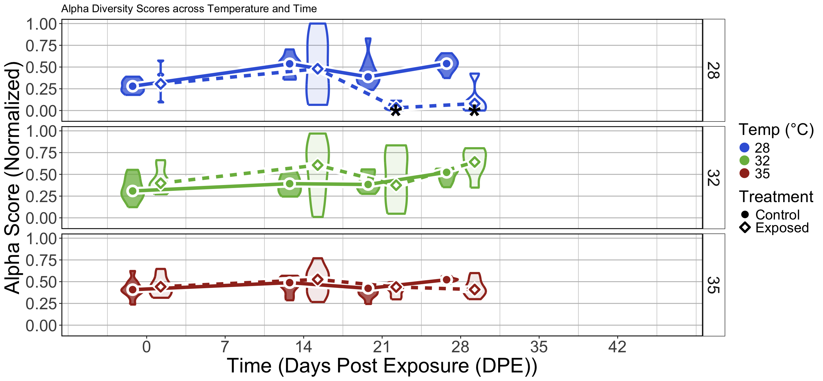
Parasite exposure alters trajectory of gut microbiome diversification at lower water temperatures
*
*
Notes:
By day 14, we start to see temperature dependent trends in diversification of the parasite exposed fish reared at 28 degrees celcius water temp
Notably,
the 28 degree parasite exposed fish display increased variation seen in the wide spread of the violin plot,
1) From 21 to 28 days post exposure, the alpha diversity scores of these 28 degree parasite exposed fish are significantly less than the control fish
These results indicate sensitivity of the gut microbiome to parasite exposure at 28 degree water temperature
2) Whereas, the trend in alpha diversity scores for the 32 and 35 degree parasite exposed fish are relatively temporally stable and do not differ to their controls
These results indicate the gut microbiome's resistance to parasite exposure at higher water temperatures

Slide 14
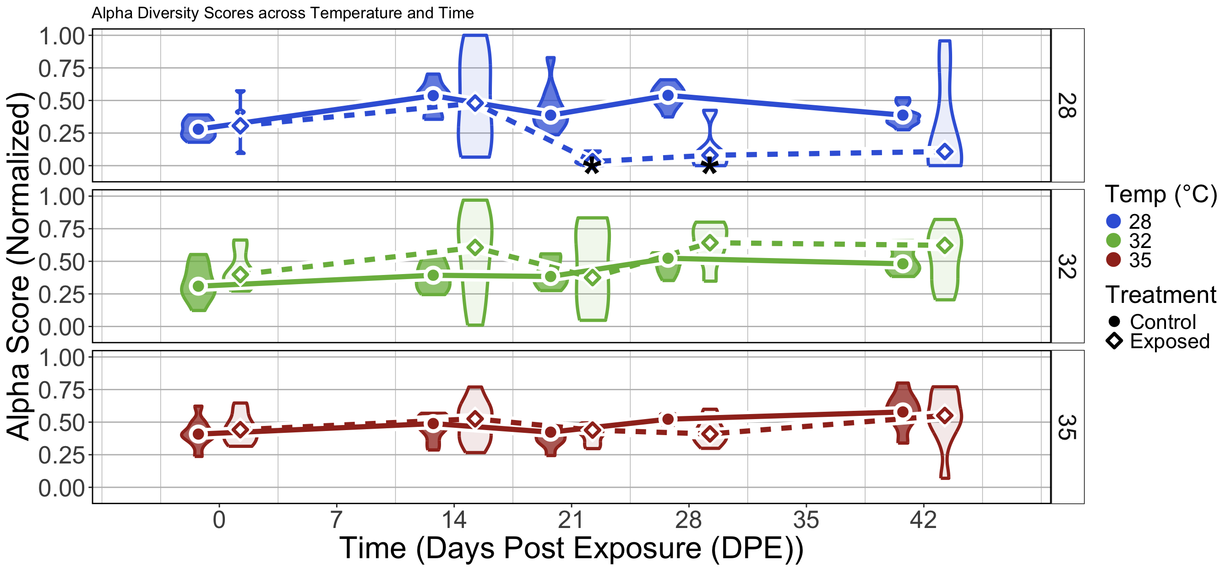
Water temperature moderates gut microbiome’s sensitivity to parasite exposure
*
*
Notes:
By the end of the experiment, we do not find statistically significant differences between treatment groups across each of the temperature groups,
but there is substantial variation within the parasite exposed groups of the 28 and 32 degree fish indicating sensitivity, and this is likely contributing to our inability to detect statistically significant differences
Collectively, these results suggest that in terms of alpha diversity, the gut microbiome's sensitivity to parasite exposure is a function of water temperature.

Slide 15
Gut Microbial Community Composition
Notes:
Next we sought to determine how parasite exposure affected gut microbiome community composition across increasing water temperatures and time

Slide 16
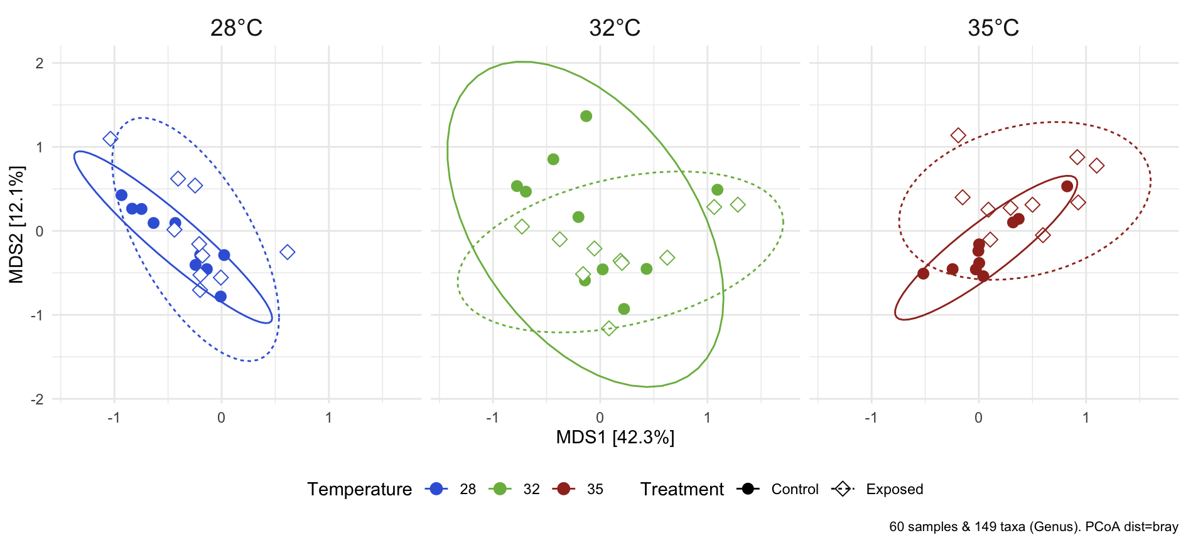
Baseline gut microbial community composition prior to parasite exposure
PERMANOVA: P = 0.156
Dispersion: P = 0.445
PERMANOVA: P = 0.083
Dispersion: P = 0.755
PERMANOVA: P = 0.009
Dispersion: P = 0.125
Notes:
Here I’m showing beta diversity ordination plots facetted by water temperature
The x- and y-axes, labeled MDS1 & 2, represents percent of the variation in Bray-Curtis dissimilarity distance derived from multidimensional scaling
Each point on the plots represents a unique sample, and the points are colored by water temperature.
Again, Circles represent control samples and diamonds represent parasite exposed samples
And, for those not familiar with these plots, the closer the points are to each other indicates that microbial communities of those samples are more similar to one another, and if points are further away that indicates that the communities are more different
This figure is only showing the results for our baseline sampling time point prior parasite exposure.
And, PERMANOVA tests, did not find statistical differences between the centroids of the treatment groups within the 28 and 32 degree water temperature groups prior to parasite exposure.
But it did detect a significant difference in the 35 degree fish, indicating that gut microbial communities of fish reared at 35 degrees differ from one another.
Together, these results indicate that the gut microbial community compositions at lower water temperatures are initially more similar to one another prior to parasite exposure.

Slide 17
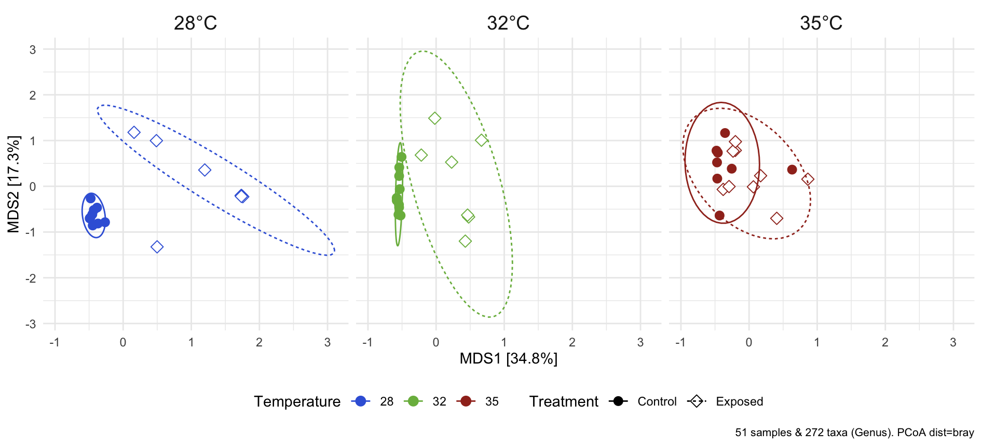
Parasite exposure restructures the gut microbiome in a water temperature dependent manner by 42 days post exposure
PERMANOVA: P < 0.001
Dispersion: P < 0.001
PERMANOVA: P < 0.001
Dispersion: P = 0.0016
PERMANOVA: P = 0.002 Dispersion: P = 0.761
Notes:
And finally, skipping ahead to 42 days post exposure, we see that fish gut microbial communities become statistically different between the treatment groups across each temperature group by the conclusion of the experiment.
Additionally, we detected elevated beta dispersion levels in 28 and 32 degree parasite exposed fish.
- These results indicate that these parasite exposed fish reared at the same temperature are less consistent to one another
Collectively, these results indicate that gut microbial communities of fish reared at lower temperatures are more sensitive and inconsistent to the effects of parasite exposure relative to fish reared at higher water temperatures

Slide 18
Infection & Microbiome
Notes:
Because I observed variation in the gut microbiome responses to parasite exposure across water temperature and time, I then wanted to see how this variation might associate with the infection outcomes I discussed earlier

Slide 19
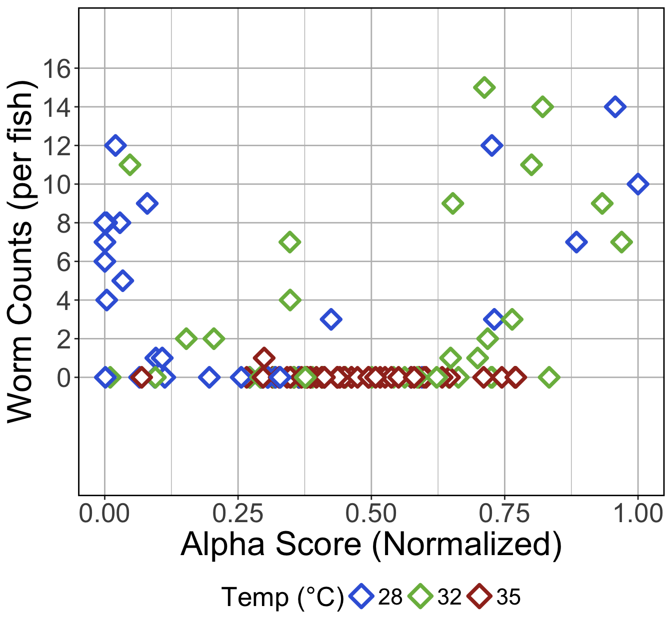
Non-linear relationship between infection burden and alpha diversity scores
Notes:
To do that, I first plotted infection counts by alpha diversity score for parasite exposed fish.
Infection counts are on the y-axis,
And alpha diversity scores are now on the x-axis
Each diamond represents a unique sample

Slide 20
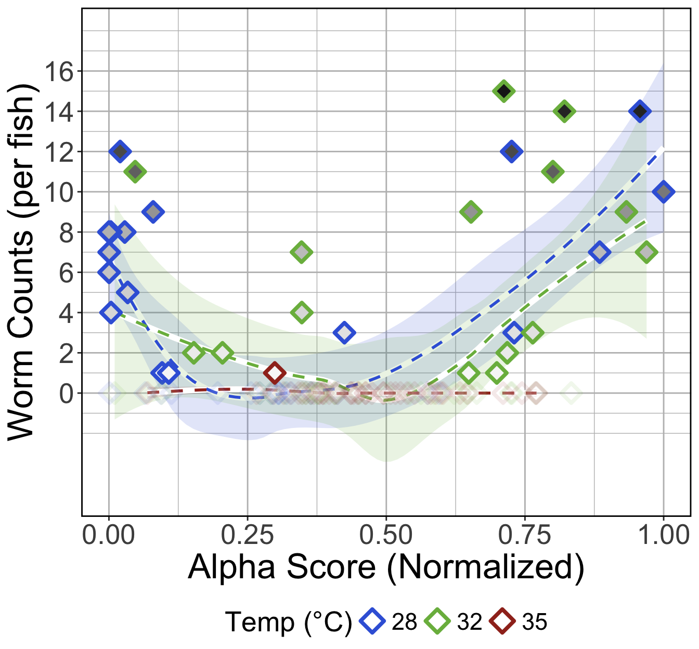
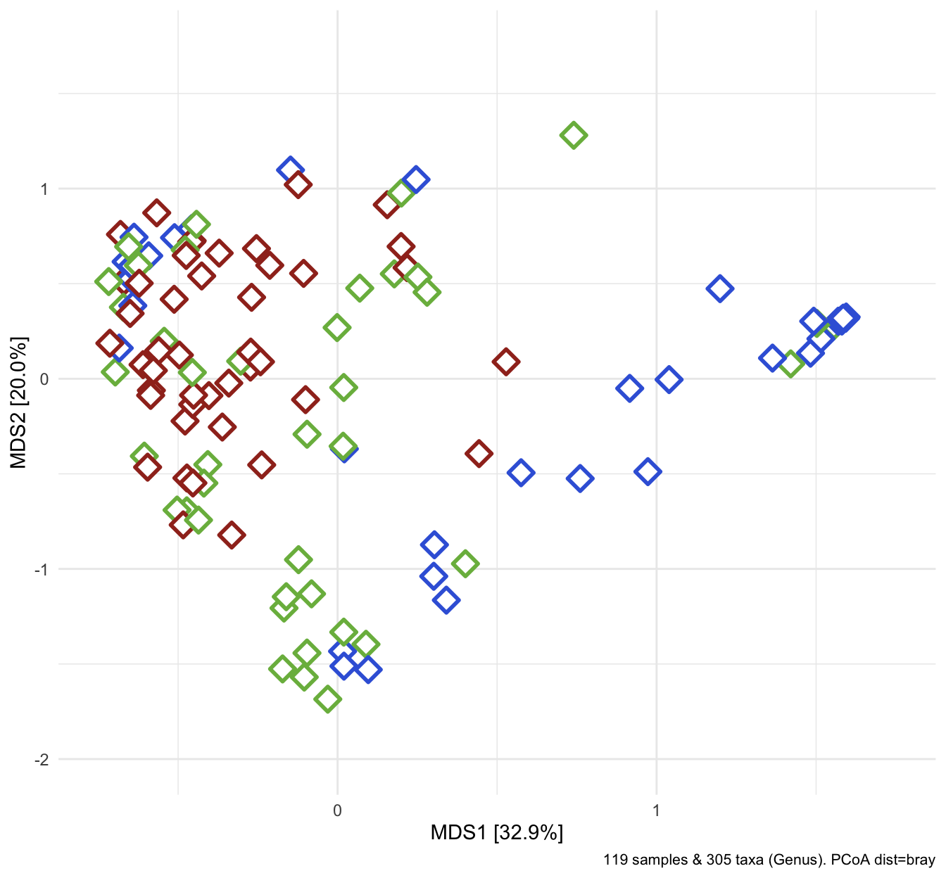
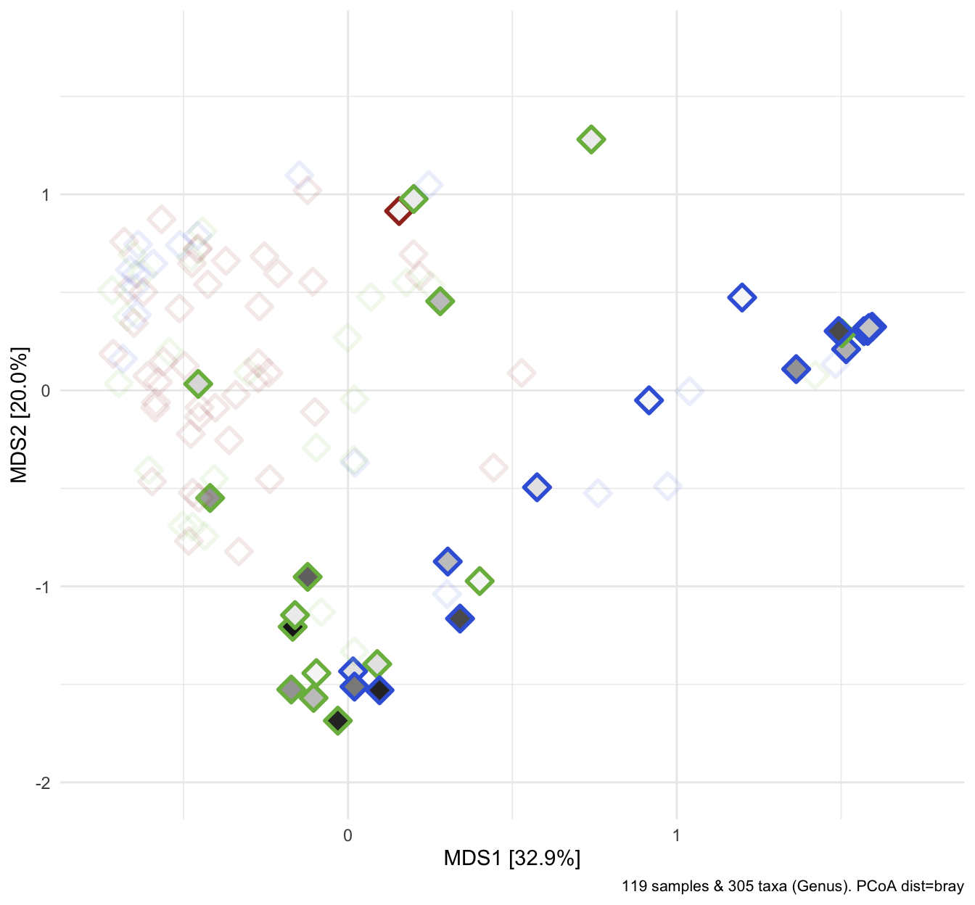
Higher infection burden in fish with lowest and highest alpha diversity scores
High
infection
burden
Uninfected
fish
Highly
infected
fish
Notes:
I found an interesting non-linear trend between high infection count and alpha diversity
Infection burden is indicated by the darker filled diamonds, and samples with no infection are transparent
1) We see that fish with highest infection burden tend to associate with either highest or lowest alpha diversity scores relative to uninfected fish
2) I then wanted to see if these infection trends manifested in beta diversity space as well
3) I observed samples with the highest infection burden were furthest away from uninfected samples suggesting that the microbiome community compositions of heavily infected fish differed from uninfected fish

Slide 21
Higher infection burden in fish with lowest and highest alpha diversity scores
High
infection
burden
Uninfected
fish
Highly
infected
fish
Notes:
I found an interesting non-linear trend between high infection count and alpha diversity
Infection burden is indicated by the darker filled diamonds, and samples with no infection are transparent
1) We see that fish with highest infection burden tend to associate with either highest or lowest alpha diversity scores relative to uninfected fish
2) I then wanted to see if these infection trends manifested in beta diversity space as well
3) I observed samples with the highest infection burden were furthest away from uninfected samples suggesting that the microbiome community compositions of heavily infected fish differed from uninfected fish

Slide 22
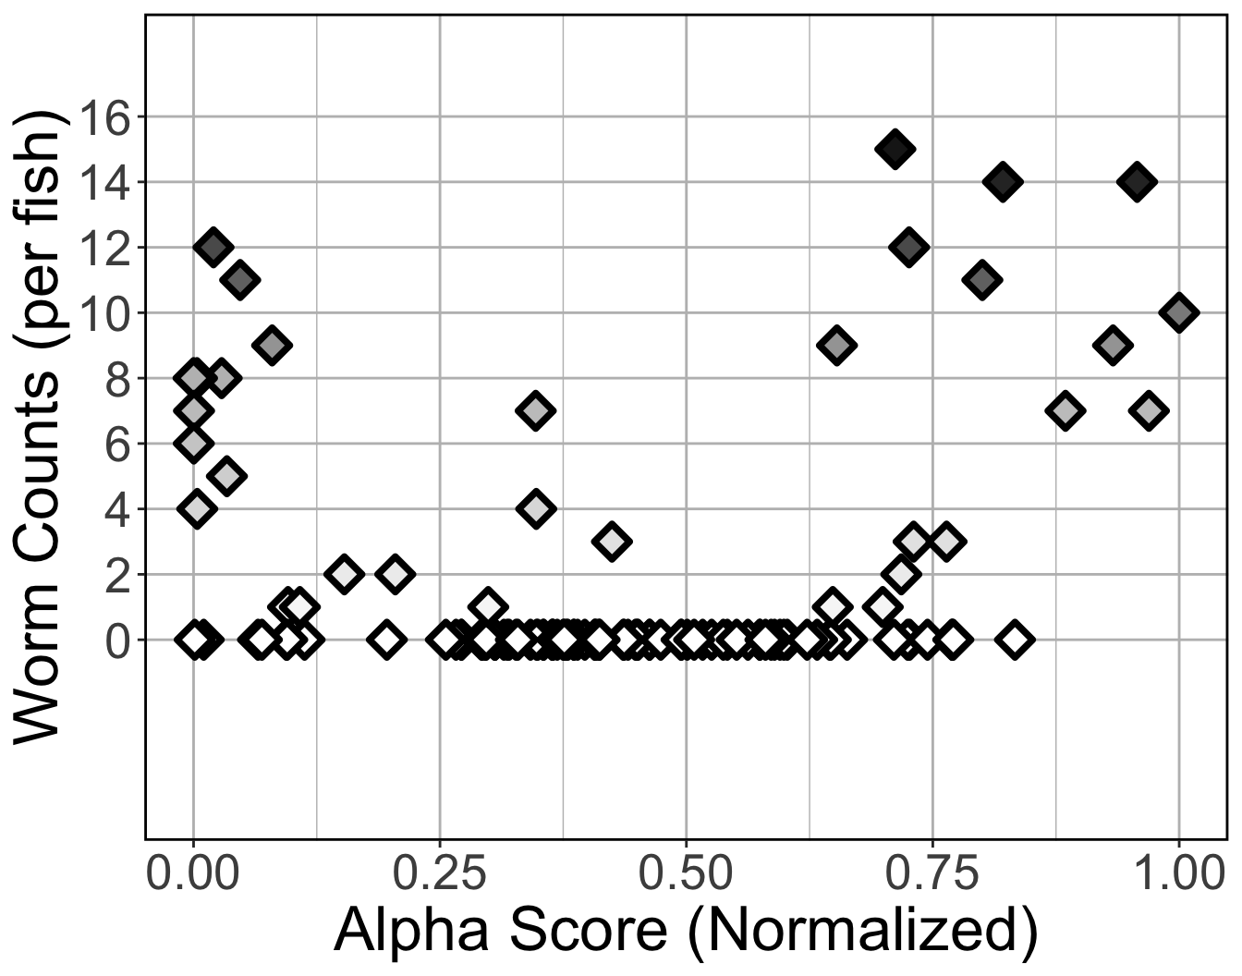
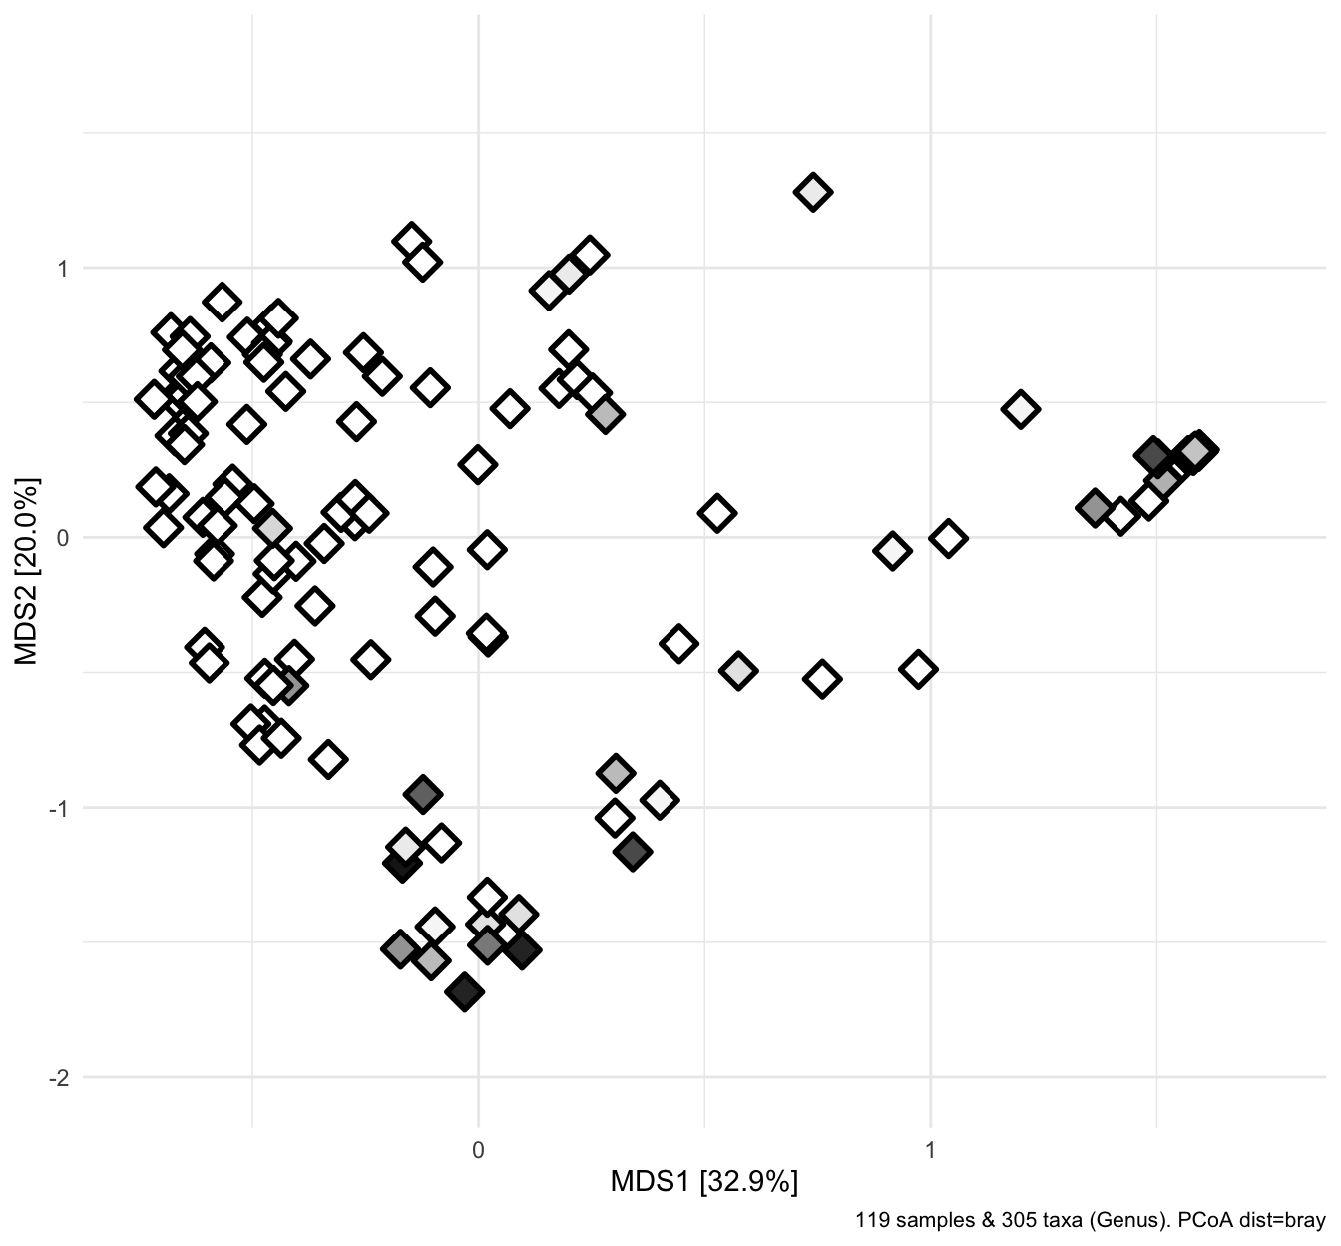
Uninfected
fish
High
infection
burden
Highly
infected
fish

Slide 23
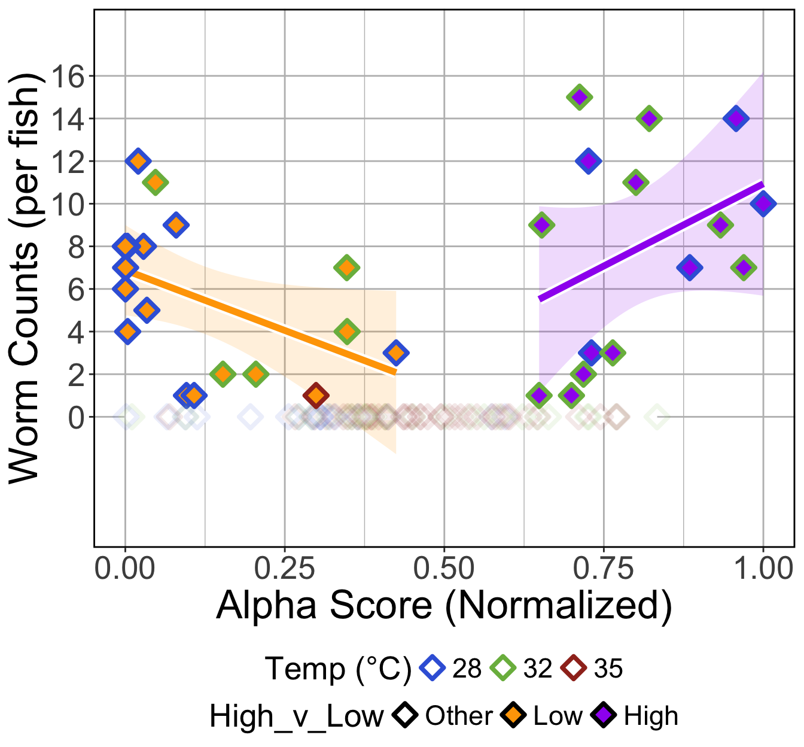
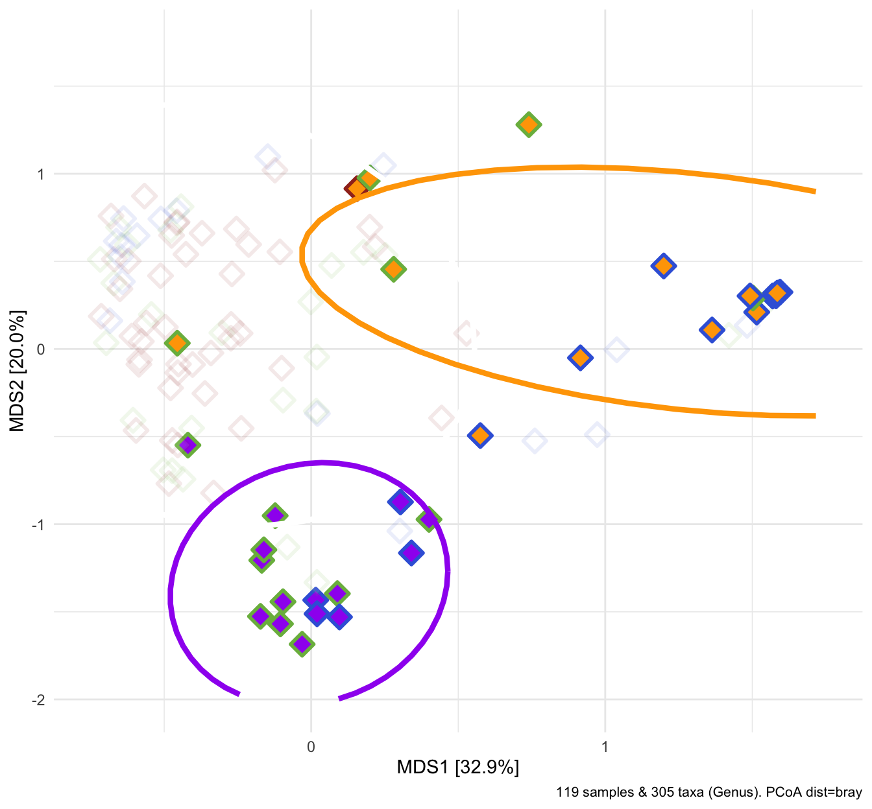
Higher infection burden in fish with lowest and highest alpha diversity scores
LOW
HIGH
LOW
HIGH
Notes:
I then grouped the samples with infections by highest or lowest alpha diversity scores
1) This grouping manifested into two distinct clusters in beta diversity space as well

Slide 24
Higher infection burden in fish with lowest and highest alpha diversity scores
LOW
HIGH
High:
28°C = 33%
32°C = 67%
Low:
28°C = 67%
32°C = 28%
35°C = 5%
LOW
HIGH
Notes:
I found that the high alpha diversity group was mostly composed of 32 degree fish
While, the low alpha diversity group was predominantly composed of 28 degree fish

Slide 25
LOW
HIGH
High:
28°C = 33%
32°C = 67%
Low:
28°C = 67%
32°C = 28%
35°C = 5%
LOW
HIGH

Slide 26
Infection outcome and gut microbiome response varies across water temperatures
LOW
HIGH
LOW
HIGH
Notes:
These results highlight an important environmental contextual relationship between infection outcomes and microbiome response.
In particular, these results have implications for how we think about ecological concepts such as the Anna Ka-RE-NI-NA Principle in the context of climate change’s impacts to the gut microbiome

Slide 27
Ignoring environmental conditions may obscure latent patterns in microbiome responses to an exogenous stressor
Notes:
According to the Anna Karenina Principle, dysbiotic or “unhealthy” microbiome communities display characteristics of stochasticity and a high degree of variation in microbiome measurements suggesting an unstable state
similar to what we see here in both plots, where samples with high infection are seemingly randomly scattered and not following a deterministic pattern or linear trend

Slide 28
Considering environmental conditions reveals nuanced microbiome responses to an exogenous stressor
LOW
HIGH
LOW
HIGH
Notes:
However, when we consider the environmental conditions of a gut microbiome’s response to a stressor, the Anna Karenina Principle seemingly diminishes and multiple alternative stable states emerge,
Thus demonstrating that when we carefully consider the environmental context of a gut microbiome and its host, we can reveal otherwise latent or obscured patterns in microbiome responses to exogenous stressors. Elucidating these patterns is critical to uncover potential underlying causal mechanisms, AND for evaluating and predicting microbiome stability and host homeostasis to exogenous stressors
---
Simon Levin: Once patterns are detected and described, we can seek to discover the determinants of pattern, and the mechanisms that generate and maintain those patterns. With understanding of mechanisms, one has predictive capacity that is impossible with correlations alone. (THE PROBLEM OF PATTERN AND SCALE IN ECOLOGY; 1992)

Slide 29
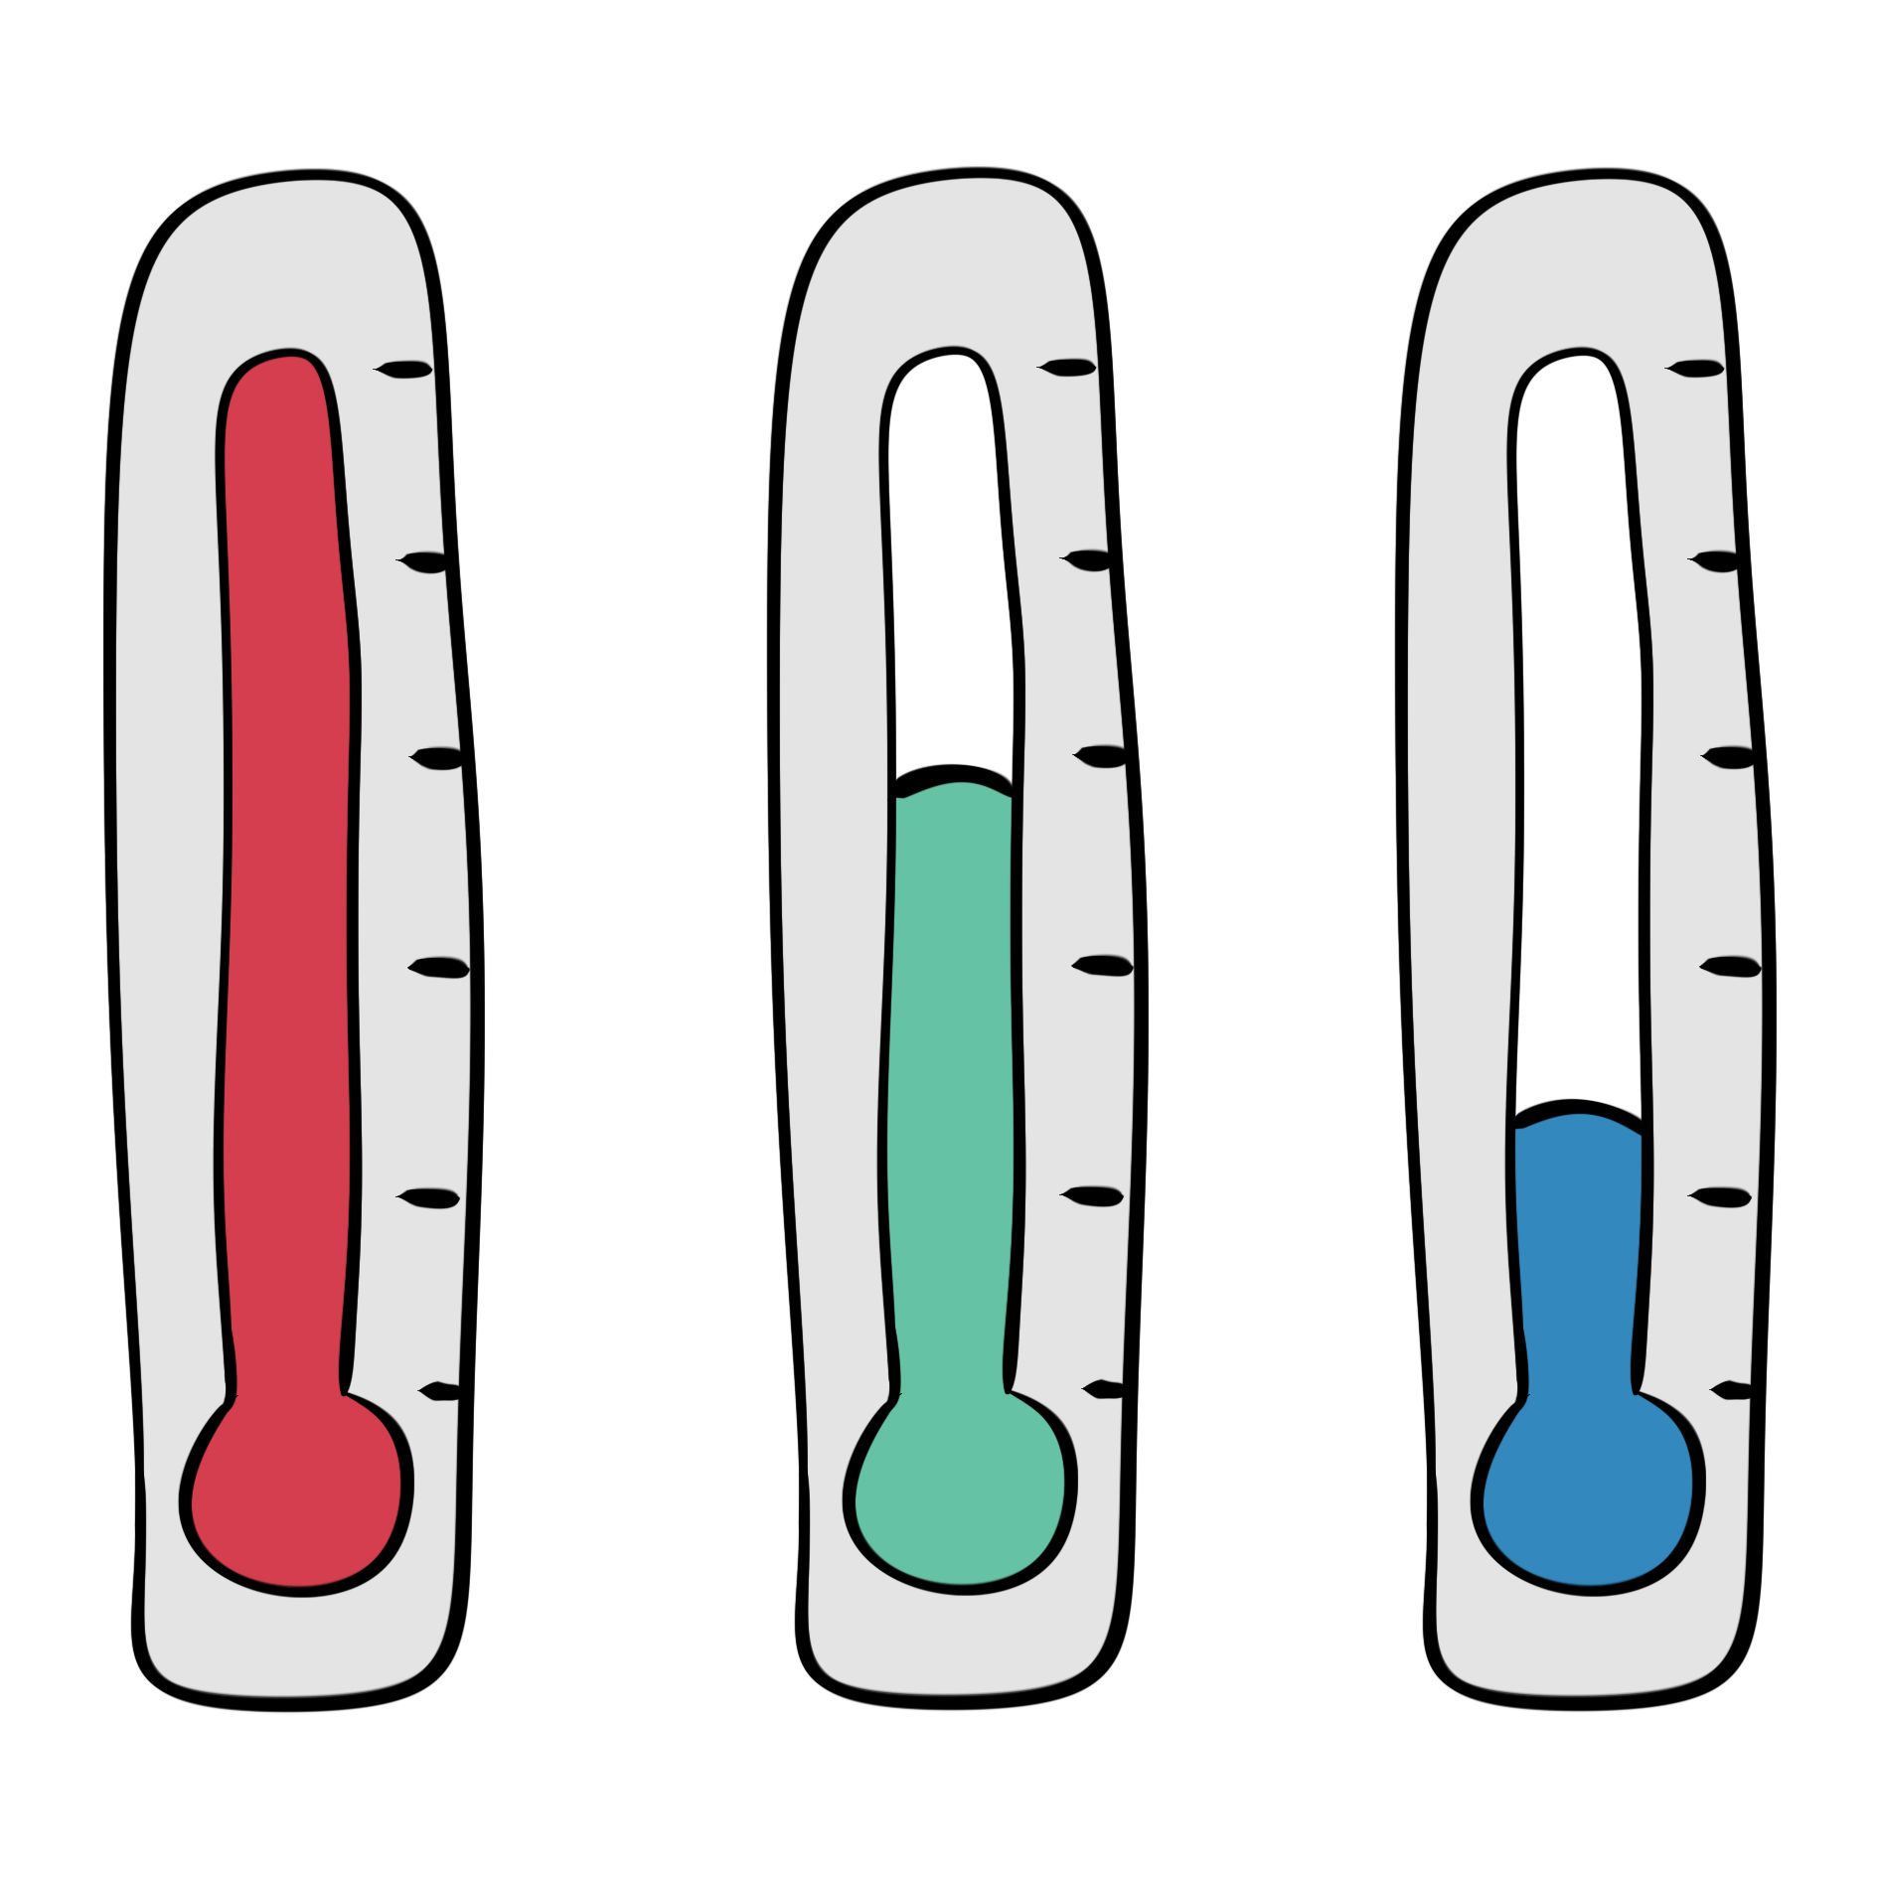

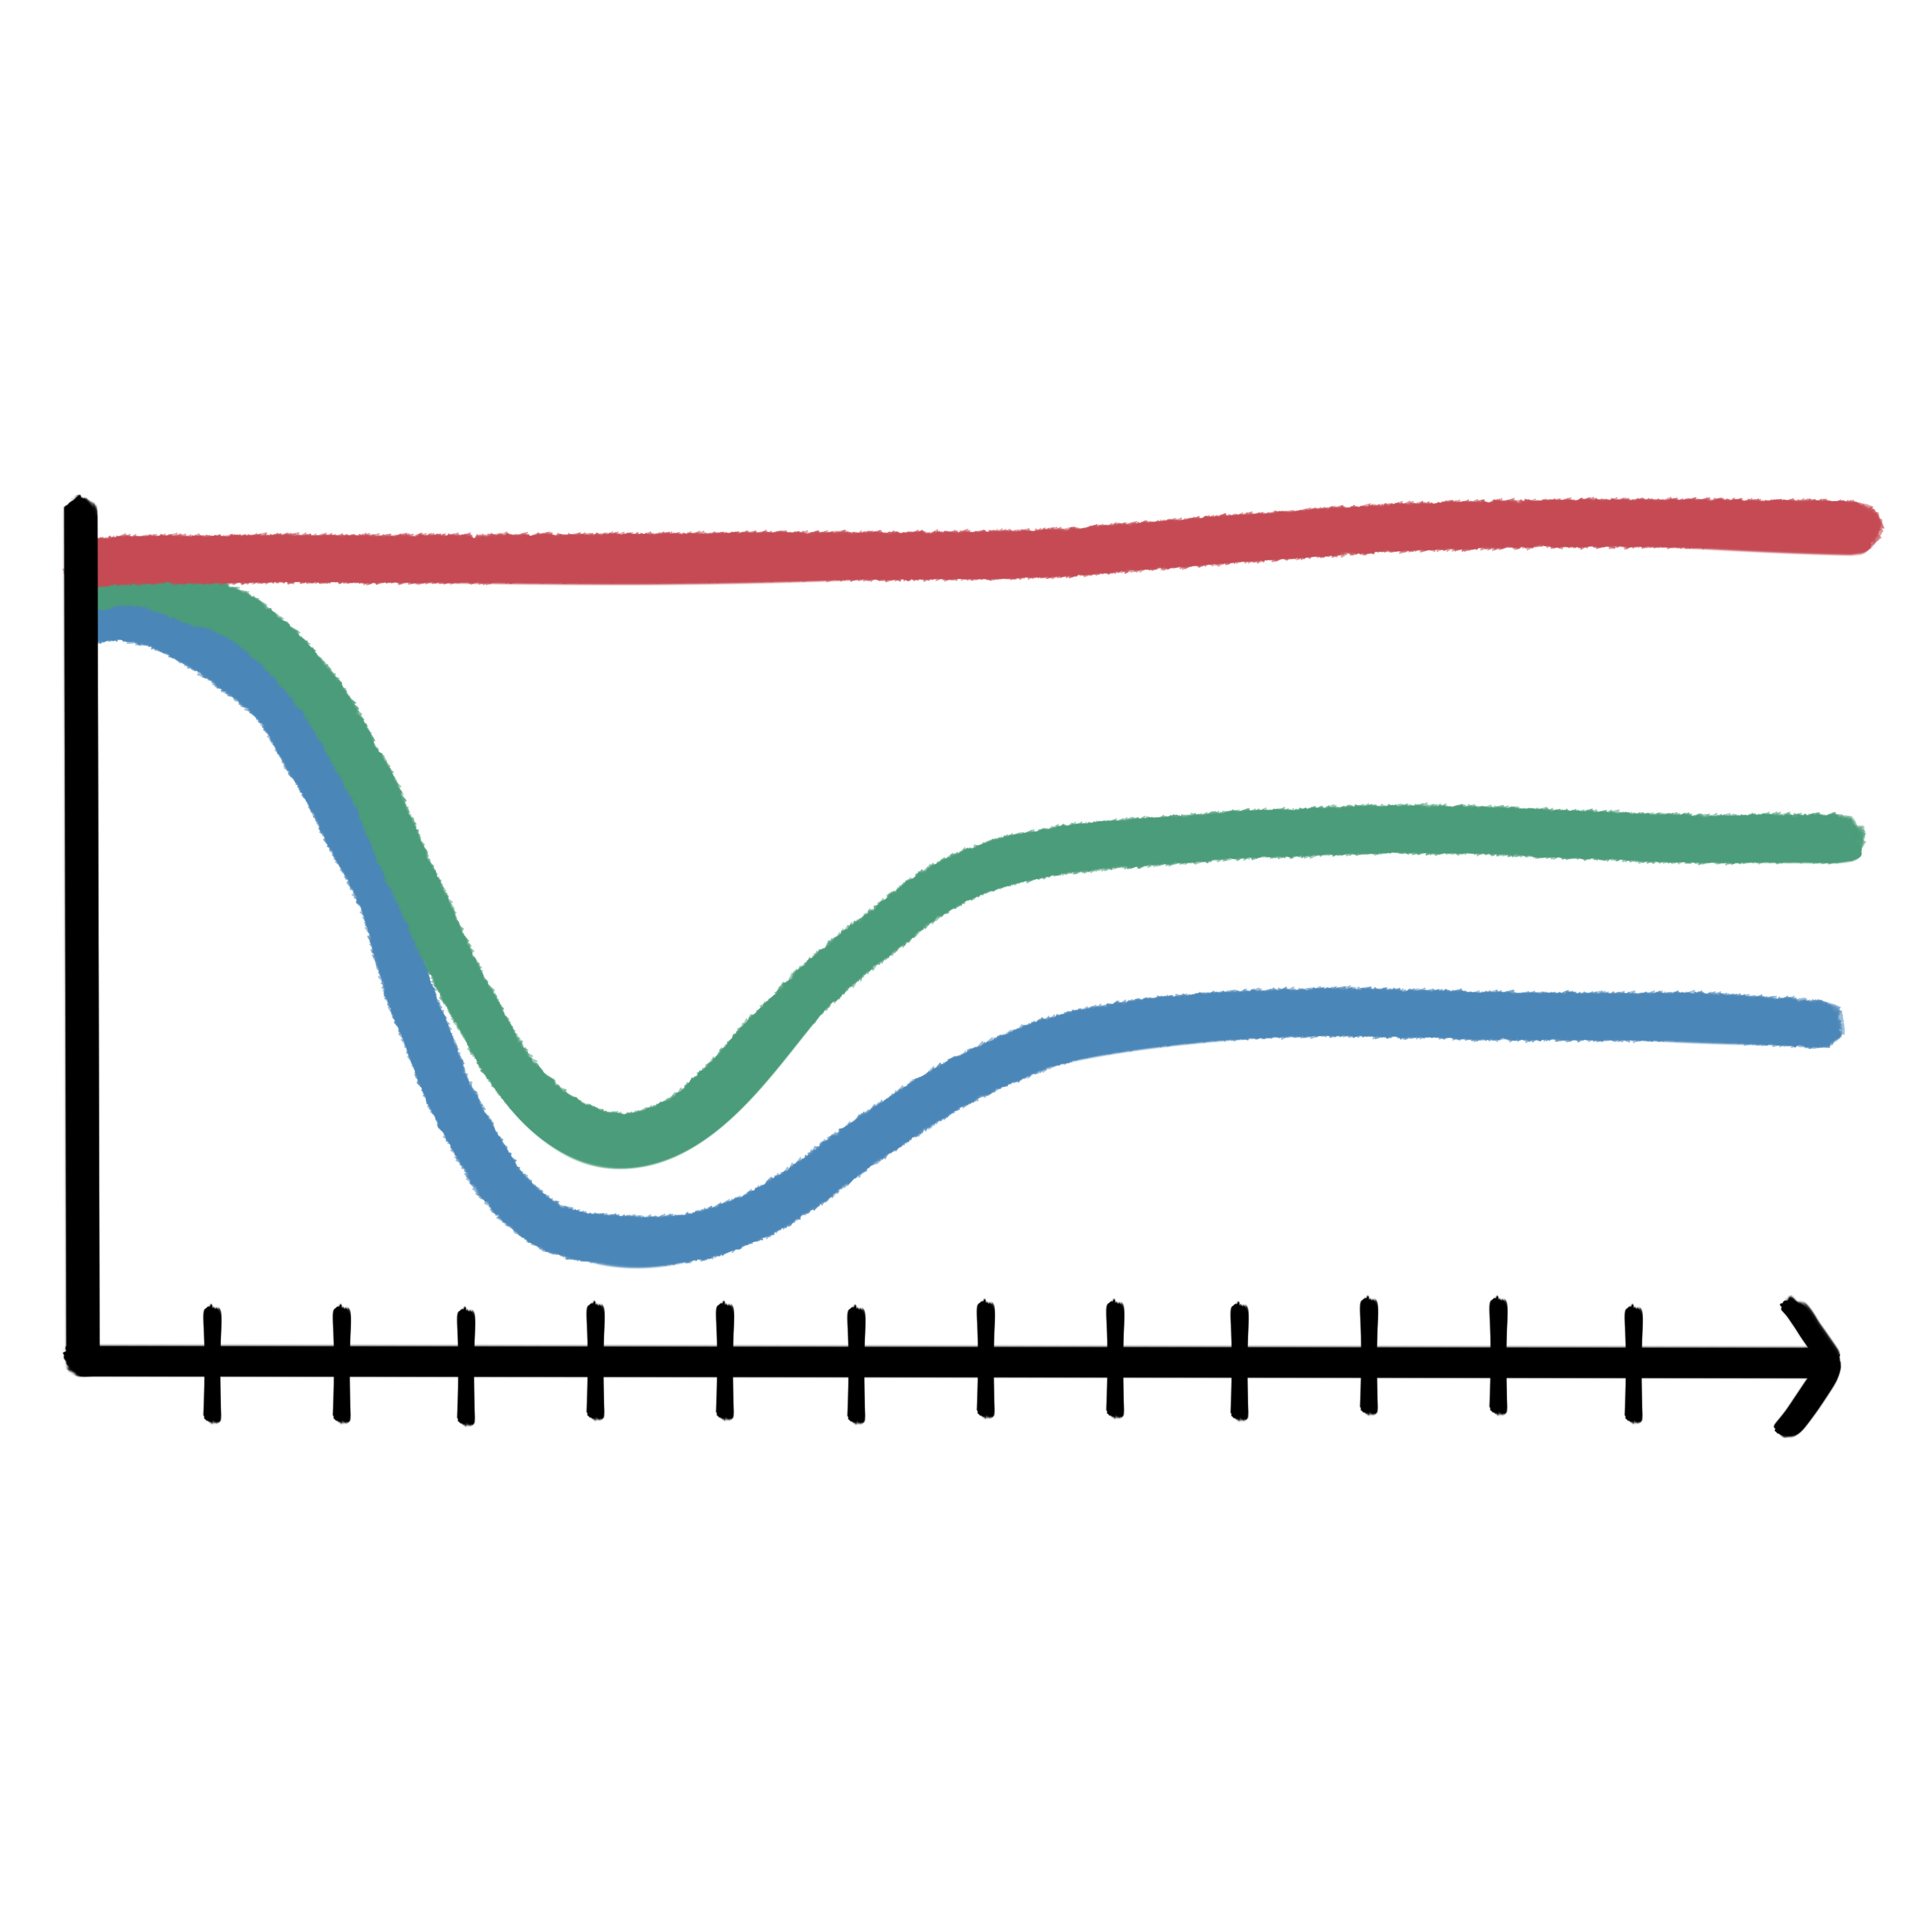
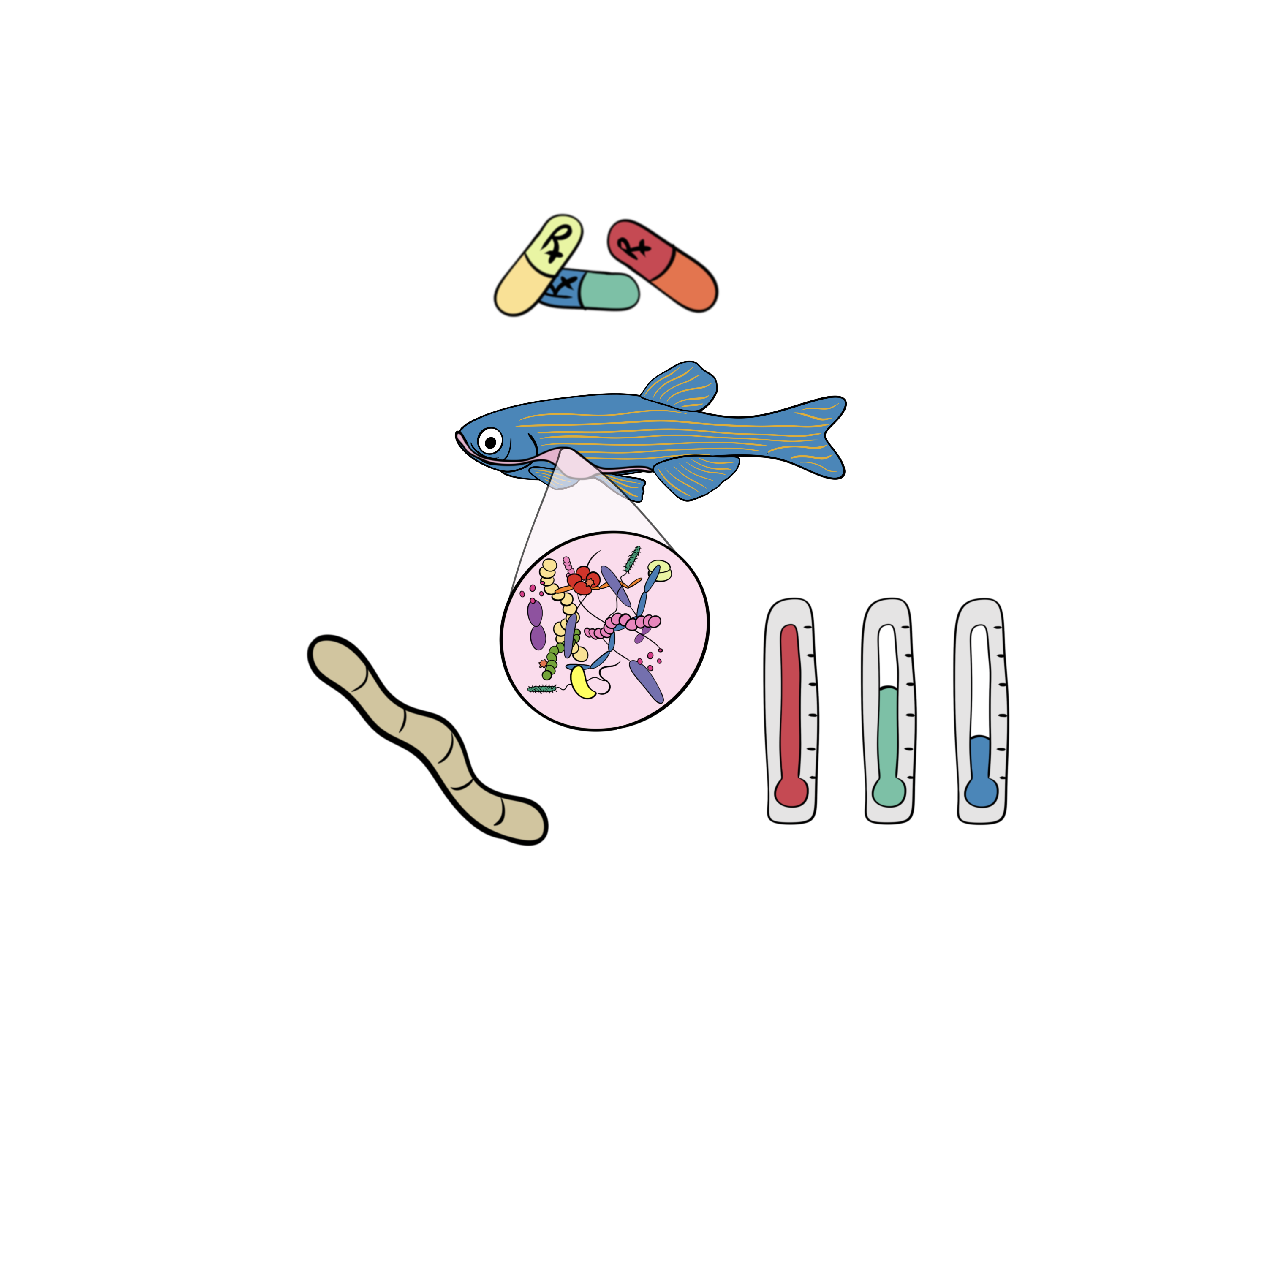


Background contextual landscape shapes microbiome response to exogenous stressors
Infection burden and sensitivity of the gut microbiome is highest among fish reared at lowest water temperatures
Microbiome’s buffering capacity against exogenous stressors may be environmentally contingent
More work is needed to clarify causal direction between gut microbiome-infection axis, and new measures of temporal response
?
Notes:
In conclusion,
We found that highest infection burden and sensitivity to parasite exposure was observed in lower water temperature reared fish, while gut microbiomes of fish reared at higher water temperatures were more resistant to the effects of parasite exposure
These findings support the notion of the gut microbiome’s buffering capacity against exogenous stressors.
And that, this buffering capacity may be environmentally contingent
3) However, it may also be the case that increasing water temperatures impacted parasitic worm infectivity and consequently the microbiome was unAFFected.
Additionally, our study did not consider contributions of the host and their immune system which may interact with the microbiome to resist infection
So, ongoing work is investigating the parasitic worm’s ability to reproduce and infect fish across a range of water temperatures to clarify the causal direction of the microbiome-infection axis
I’m also developing novel methods to further tease out nuanced microbiome measures of temporal stability
Overall, our study demonstrates that anthropogenic climate change may have unanticipated and environmentally-specific impacts to ecosystems and organismal health, which has important implications for how we as researchers and society develop context-appropriate approaches to study, address and resolve the impacts of climate change to ecosystems and individual health

Slide 30


Acknowledgements
Sharpton Lab:
Alex Vompe
Austin Hammer
Ebony Strong
Emilee Lance
Sebastian Singleton
Dr. Alex Alexiev
Dr. Kristin Kasschau
Dr. Thomas J. Sharpton
Kent Lab
Kelan Elliot & Ruby Scanlon
Colleen E. Al-Samarrie
Connor Leong
Dr. Corbin Schuster
Dr. Mike L. Kent
Collaborators
David Lab
Fern Lab
Mueller Lab
Vega Thurber Lab
Funding Sources
NSF Grant 2025457
Oregon Dept. of Fish & Wildlife
Seeking a postdoc summer 2025
Multi-omic microbiome bioinformatics
Notes:
With that, I’d like to thank my collaborators and funders for supporting my research efforts
1) I’ll be graduating summer 2025, so please reach out to me if you’re looking for a microbiome data scientist to join your lab

Slide 31

Thank you!
Michael Sieler
sielerjm@oregonstate.edu
MichaelSieler.com
Notes:
And I’d like to thank you for your time and attention, and I’ll happily take any questions

